Slide 1
Rain Prediction next day
Alekhya Devi Ranabothu

Slide 2
Motivation
Planning daily activities
Scheduling outdoor sports
To avoid or minimize the destruction of weather hazards

Slide 3
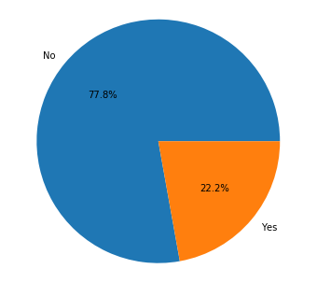
Exploratory Data Analysis
Weather data of Australia from Kaggle
Independent variables (numerical , ordinal,
categorical) - 23
Target variable(RainTomorrow) –binary
Few important independent variables
RISK_MM , Rainfall , RainToday
Imbalanced data
41k samples

Slide 4
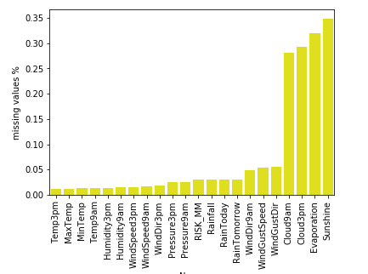
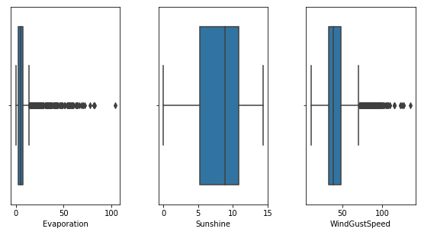
Data Analysis (contd..)
Outliers
Missing values

Slide 5
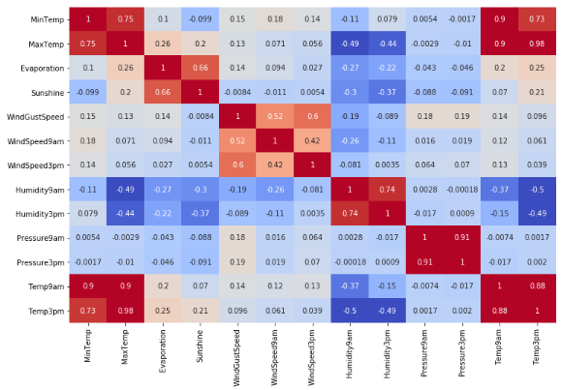
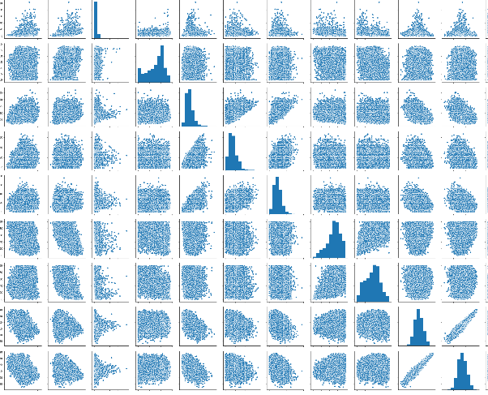
Distribution
Correlation

Slide 6
Data Preprocessing
Removing RISK_MM, Rainfall
Handling outliers
Imputing missing values
Feature scaling

Slide 7
Predictive models and metrics
Supervised classification
Logistic Regression
Random Forest
SVC
Neural Networks
Evaluation metrics
F1-score
K-fold cv
Learning curves

Slide 8
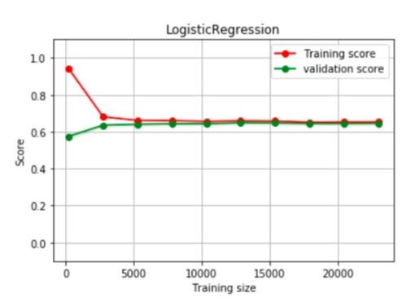
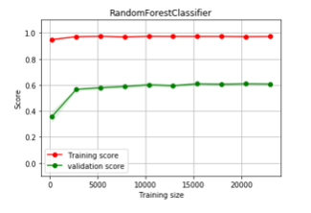
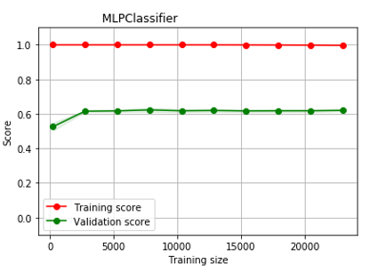
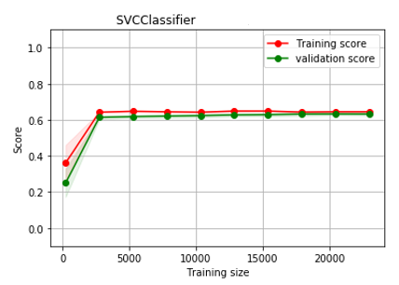
Experiments and Results
Logistic Regression
SVC
Random Forest
Neural Networks

Slide 9
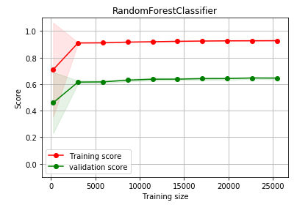
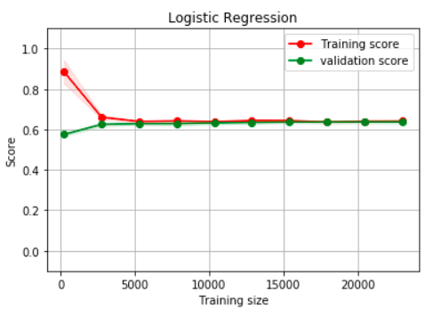
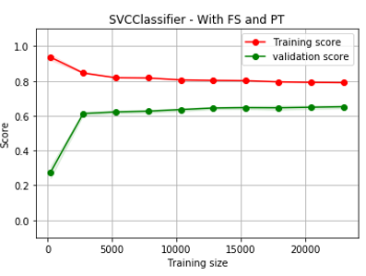
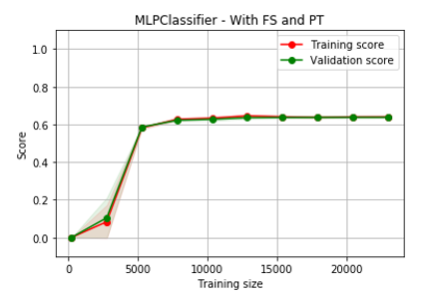
Experiments and Results
Logistic Regression
SVC
Random Forest
Neural Networks

Slide 10
Feature Selection
Correlation
Recursive Feature Elimination with CV
Parameter Tuning
Logistic Regression – regularization parameter, solver, max_iter
Random Forest– n_estimators, max_features, min_samples_leaf, max_depth
SVC – C,gamma,kernel
NeuralNetworks- hidden nodes,hidden layers,activation,learning rate

Slide 11
Test Results Comparison
Algorithm | Without feature selection and tuning |  | Feature selection and parameter tuning
 | 0 | 1 | 0 | 1
Logistic Regression | 0.91 | 0.62 | 0.91 | 0.64
SVC | 0.91 | 0.62 | 0.91 | 0.65
Random Forest | 0.91 | 0.61 | 0.91 | 0.66
Neural Networks | 0.89 | 0.62 | 0.91 | 0.64

Slide 12
Discussion
Better performance with Non-linear models
Future Work
Predicting heavy rains
Forecasting temperature
Forecasting strength of wind

